Slide 1




2026 Energy Innovation Hackathon
From smart-meter data to battery programs
Classifying appliances, segmenting 33,927 homes and sizing behind-the-meter batteries from one year of hourly AMI
Team 08 · MIT Climate Hackers | Conor Mcmanamy, Charlotte Adriaenssens, Charles Loriot

Slide 2
Electrified homes drive peak load; target batteries
EXECUTIVE SUMMARY
Based on hourly meter data about 33,927 Avangrid homes
2,582
34%
≈20%
2,263
home EV chargers detected: 3.5x what the labels imply
of the winter peak comes from 16% of homes (electric heat)
heat-pump adoption makes the system peak in winter (20%-36%)
Tier 1 battery homes: 3.4 MW summer / 2.6 MW winter relief
What we recommend
Battery + managed-charging bundle for the 768 electrified Tier 1-2 homes (EV + electric heat): 9% of the winter peak from 3% of homes.
Batteries with heat-pump conversion in electric-heat homes: the largest Tier 1 pool (1,245 homes, 2.5 MW winter relief in Tier 1-2).
Coordinate fleet recharge before heat pumps scale: uncoordinated overnight recharge at 30% adoption creates a 108 MW night peak; coordinated, the peak falls to 84.0 MW.
Avoided buildout ≈ $335/yr per Tier 1 home (mid placeholder $/kW-yr): target constrained feeders, electrification headroom and customer value, not the system average.

Slide 3
Hourly reads, one weather station, partial labels
THE CHALLENGE
Three questions from the brief, answered from the data Avangrid provided
34,238
8,760
186 · 88 · 397
1 Classify appliances
EV (L1 / L2), heat pump vs resistive heat, AC, PV, pool, water heater, hot tub
residential customers with AMI
hourly readings each (Sep 2025 - Aug 2026)
EV · heat-pump · PV labels present
2 Segment customers
0 negatives
311
23
load behaviour, what drives it, who drives the summer and winter peaks
3 Size batteries and flexibility
delivered-only meters: PV exports clipped to 0
excluded: 229 stuck, 81 short, 1 error
very-high-load accounts reviewed and kept
candidates, sizing, value as avoided buildout cost; today and in a winter-peaking future
Context data: one hourly weather series (temperature, humidity, wind). No geography, tariff or demographics, so 'what drives what' means weather → load, appliance → load shape, segment → system peak.

Slide 4
One reproducible pipeline from raw reads to programs
OUR APPROACH
bash scripts/run_all.sh rebuilds every table, figure and number in this deck
1
2
3
4
5
6
Clean & check
Physics features
Classify
Segment & drivers
Batteries & DR
Future & playbook
stuck meters, spikes, high-load review, metering type
53 explainable features per home: weather slopes, events, shape
physics gates + PU ranking; heat pump vs resistive by response shape
rule segments, K-Means archetypes, NMF parts, peak shares
hour-by-hour SOC dispatch, sizing, avoided buildout, tiers
heat-pump scenarios, 3 kVA lens, segment cards, app
Physics first
Labels only check
Honest kWh
thresholds come from equipment ratings or natural gaps in a score, never from the labels
labels and the EIA RECS survey are used as checks that are allowed to fail
batteries claim only the kW they can hold through the whole event window

Slide 5
The model in six equations
METHOD
Every flag, segment and battery number on the following slides comes from one of these
Weather response (per home, per day)
Positive-unlabeled ranking (Elkan-Noto)
kWh_{d} = β₀ + β_{h}·HDD_{d}(T_{h}) + β_{c}·CDD_{d}(T_{c}) + β_{x}·HDD_{d}(20°F) + β_{w}·HDD·wind + β_{e}·weekend
g(x) = P(labeled | x), P(owner | x) = g(x) / c, ĉ = mean g(x) over labeled
β_{x} > 0: slope steepens in deep cold (heat-pump backup); resistive heat stays linear
ĉ = 0.035 (EV), 0.011 (HP) vs 0.25 in the brief → labels not random: g used to rank only
Load decomposition (NMF)
Battery state of charge (hour by hour)
S_{i} ≈ Σ_{j} w_{ij} H_{j}, w_{ij} ≥ 0, Σ H_{j} = 1
SOC_{t+1} = SOC_{t} + η·c_{t} − d_{t}, 0 ≤ SOC ≤ E, d_{t} ≤ min(P, load_{t})
S_{i} = 12-month × 24-hour shape summing to 1, so w_{ij} = share of energy; k = 7 chosen without labels
E = 20.16 kWh, P = 7.68 kW, η = 89.4%; recharge 00-05 h only, never above the home's own p95 load
Avoided buildout ($/yr)
Battery priority score
V = p_{cap}·ΔkW_{peak} + p_{tx}·mean(ΔkW_{S}, ΔkW_{W}) + p_{dist}·max(ΔkW_{S}, ΔkW_{W})
score = 0.45·rank(V) + 0.15·persist. + 0.15·coverage + 0.15·electrified + 0.10·PV
mid $/kW-yr 60 / 100 / 75 (placeholders); NPV over 15 yr at 7%
Tier 1 / 2 / 3 = top 10% / next 20% / next 30% of 22,682 candidates

Slide 6
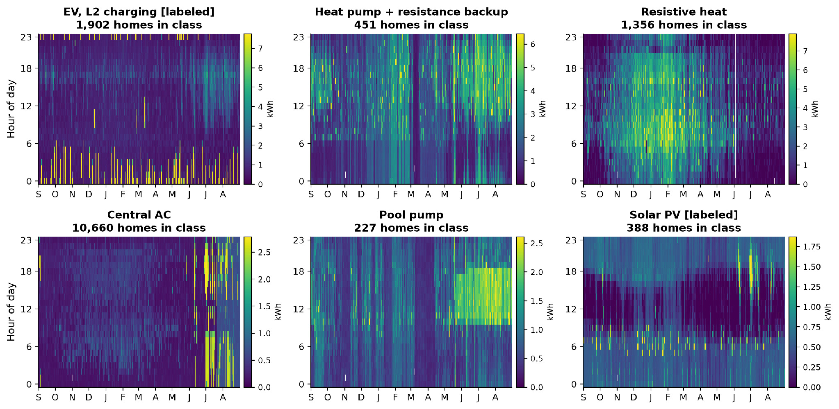
Physics signatures reveal appliances in hourly data
APPLIANCE CLASSIFICATION
One typical home per class (the medoid on the class's defining features): every hour of the year, Sep 2025 to Aug 2026
2,582
EV home charging (1,902 L2, 680 L1)
6,584
electric space heat (1,560 heat pump)
13,404
central AC
388 · 227
solar PV · pool pumps

Slide 7
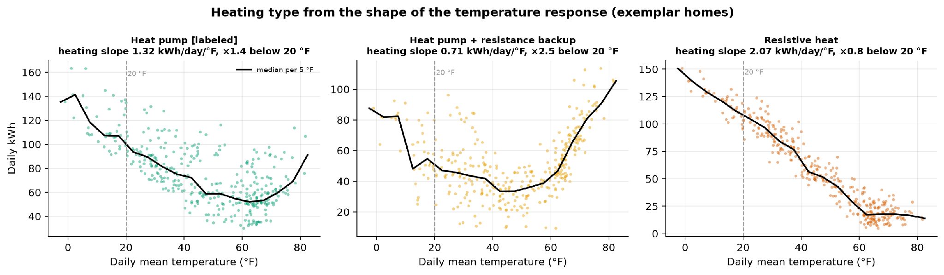
The cold-weather response reveals the heating type
APPLIANCE CLASSIFICATION
Daily kWh vs temperature for three typical homes: the slope below 20 °F tells the technologies apart
1,109
451
1,356
3,668
heat pump: moderate slope, mild steepening
heat pump + backup: slope ≥ 2× below 20 °F
resistive: steep, linear (COP = 1)
electric, type unclear at hourly resolution

Slide 8
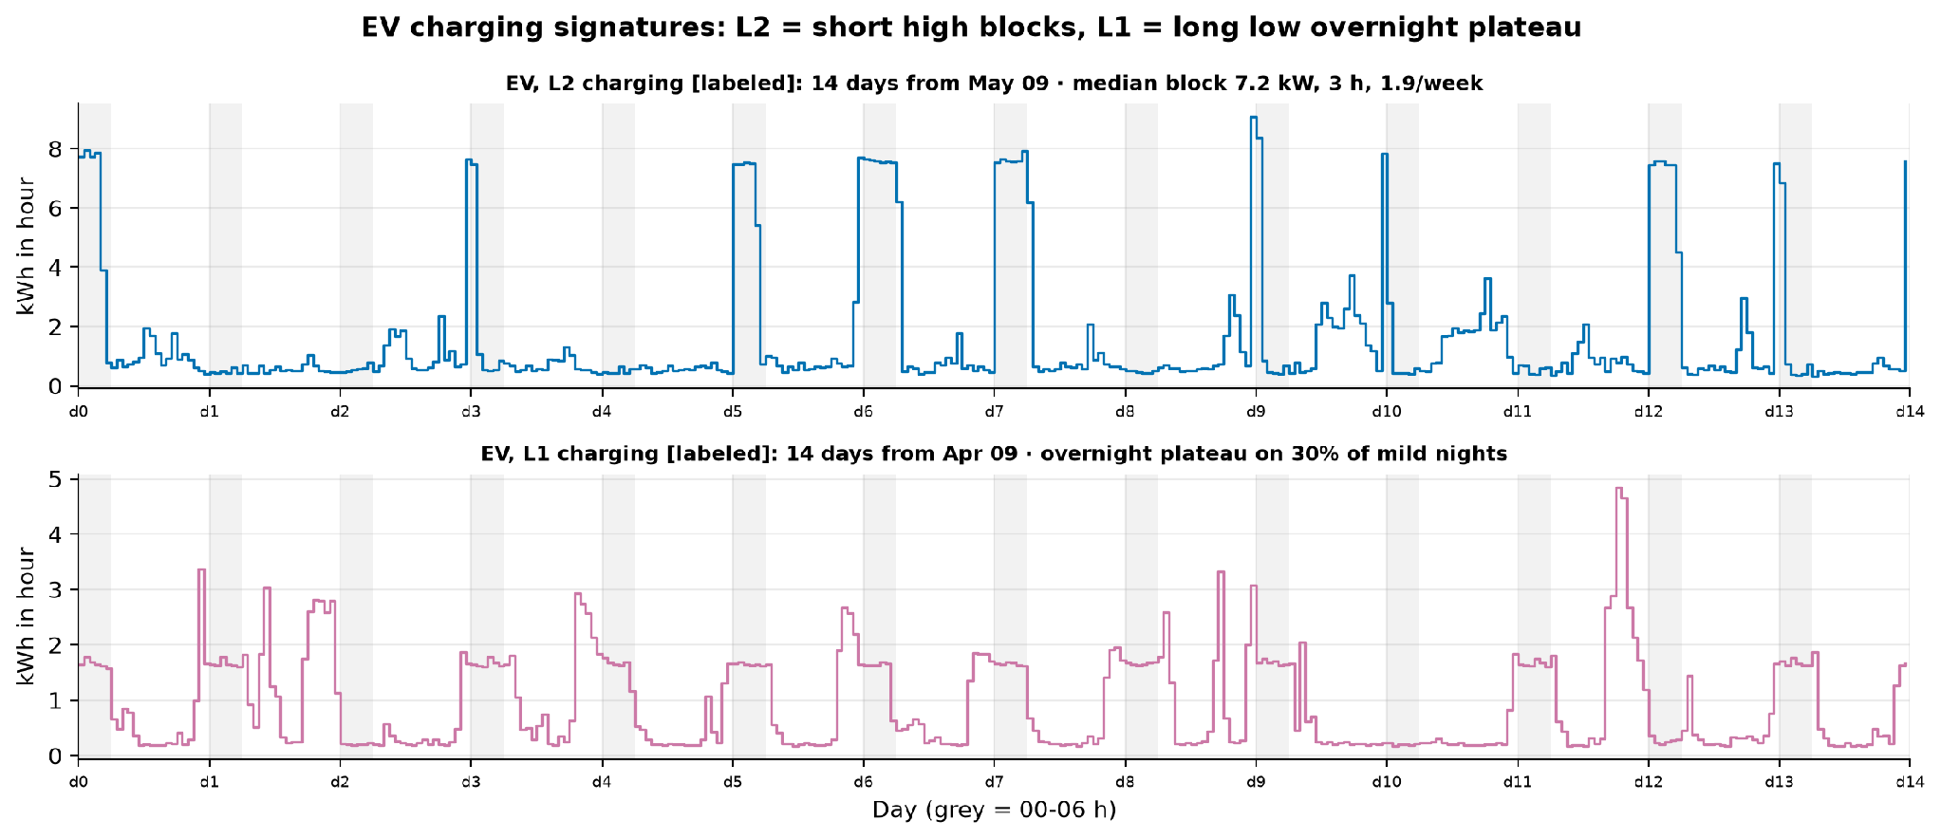
L2 and L1 charging leave different fingerprints
APPLIANCE CLASSIFICATION
Two weeks of a typical labeled L2 home and a typical labeled L1 home
1,902
L2 detectable: short high blocks ≥ 1 week in 4
680
L1 detectable: long low overnight plateau
36%
of labeled EV homes show home charging: many charge away from home or bought mid-year

Slide 9
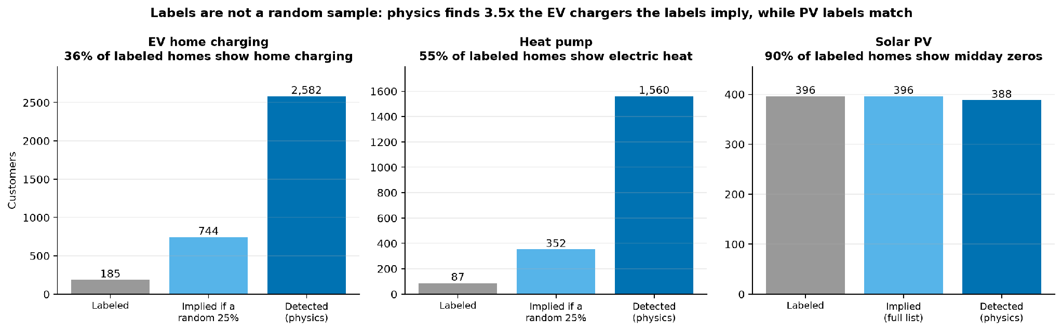
The labels are not a random sample, so physics leads
KEY FINDING
Physics finds 3.5x the EV chargers the labels imply; PV labels match the meter signature
Elkan-Noto ĉ = 0.035 (EV), 0.011 (HP) vs 0.25: PU used as a ranking
EV ranking: bagged PU LightGBM, CV AUC 0.78 (benchmark 0.74)
PV rule: 92% precision, 90% recall, 31 unregistered systems

Slide 10
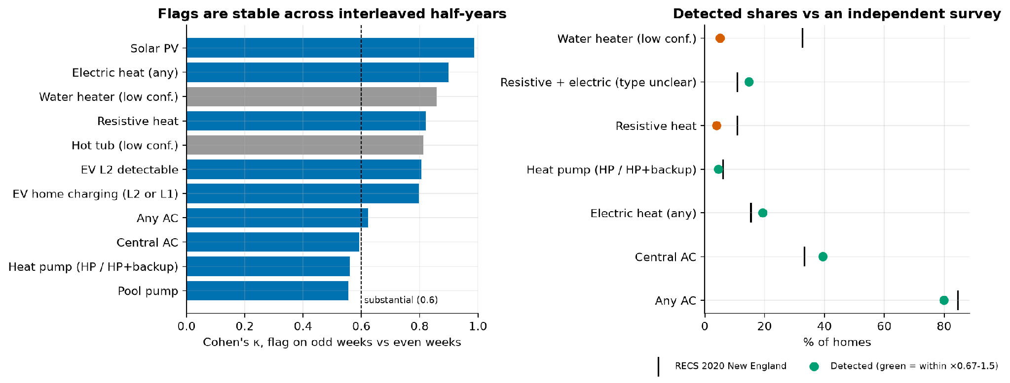
Flags are stable, seasonal and plausible
RIGOR
37 validation checks: 22 pass, 9 informational, 6 fail (3 designed to fail if labels were random, 3 survey gaps)
0.80
median Cohen's κ, flags on odd vs even weeks
9/9
seasonal checks: heating fires in winter, cooling in summer
0.761
EV PU AUC, out-of-customer and out-of-time
0
battery power / SOC / export violations

Slide 11
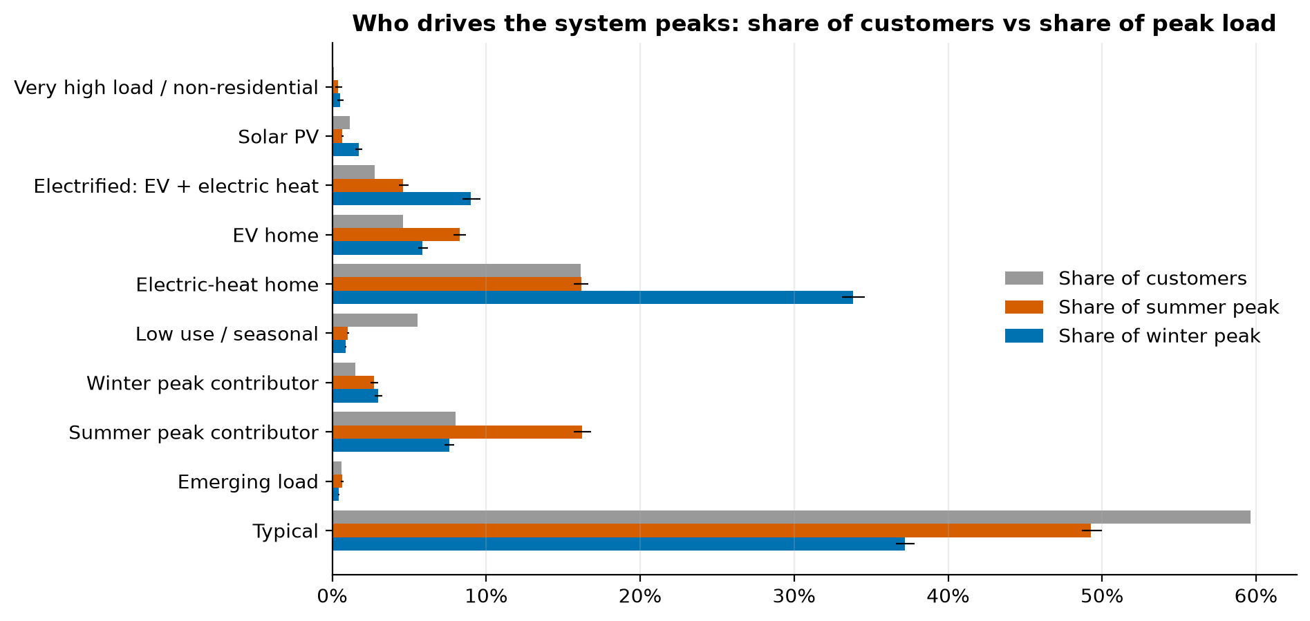
16% of homes carry 34% of the winter peak
SEGMENTATION
Share of customers vs share of the coincident summer and winter peak, by business segment (bars = 95% bootstrap CI)
16% → 34%
electric-heat homes: share of homes → share of winter peak
8% → 16%
summer peak contributors (98% central AC) → summer peak
60% → 49%
typical homes → summer peak (37% of winter)

Slide 12
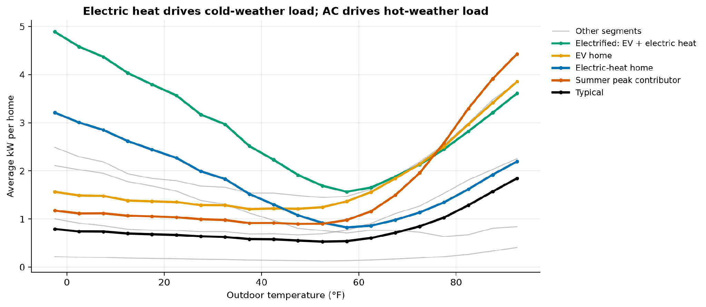
Cold drives electric-heat homes; heat drives AC homes
WHAT DRIVES LOAD
Average kW per home by outdoor temperature (left) and per appliance during the system peak hours (right)
kW per home at the system peak
5.6 kW
Resistive heat, winter peak
3.6 kW
Heat pump, winter peak
3.9 kW
Pool pump, summer peak
3.4 kW
EV, summer peak
Weather → load is causal (weather is exogenous). Appliance → peak is an association: e.g. resistive-heat homes average 5.6 kW at the winter peak.

Slide 13
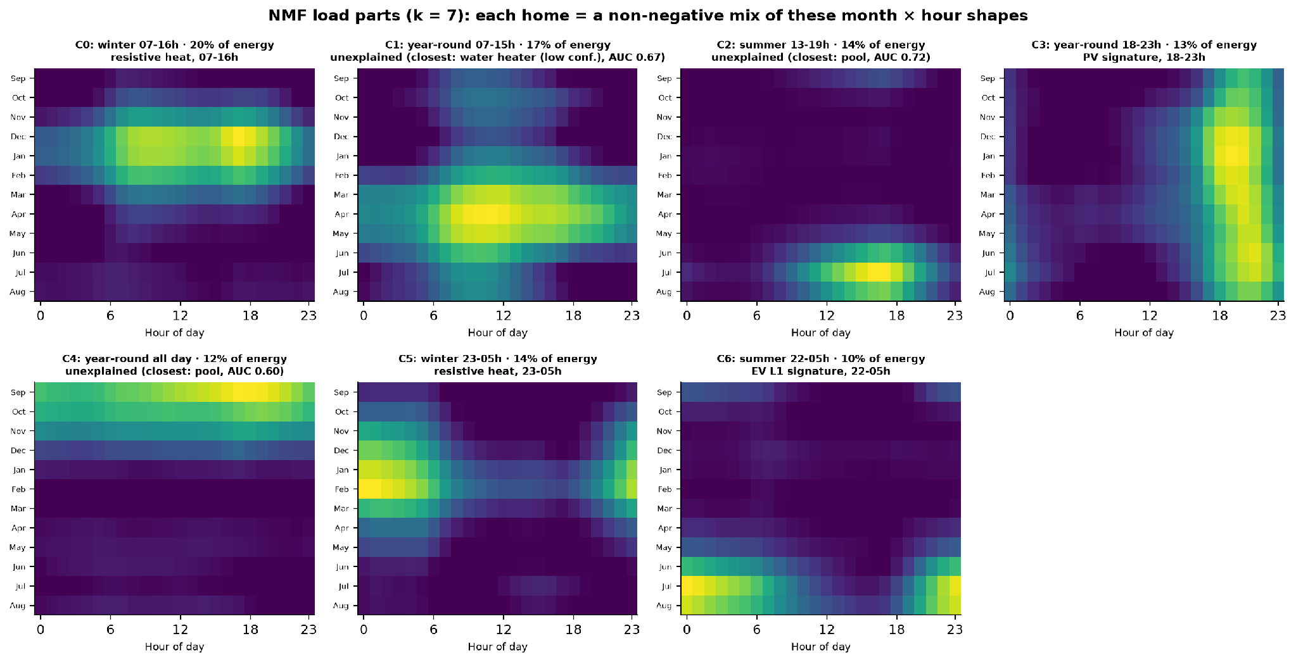
Each home mixes 7 load parts, found without labels
INNOVATION
Non-negative matrix factorisation of 12-month × 24-hour load shapes; parts described before matching them to appliances
k = 7
largest k reproduced on odd and even weeks (k = 8: cosine 0.10)
55% vs 27%
winter heating parts: share of energy, electric-heat vs typical homes
AUC 0.58
L2 charging has no part: keep the event detector
The evening 'PV' part is a metering artefact: clipped midday load shifts PV homes' measured energy to the evening.

Slide 14
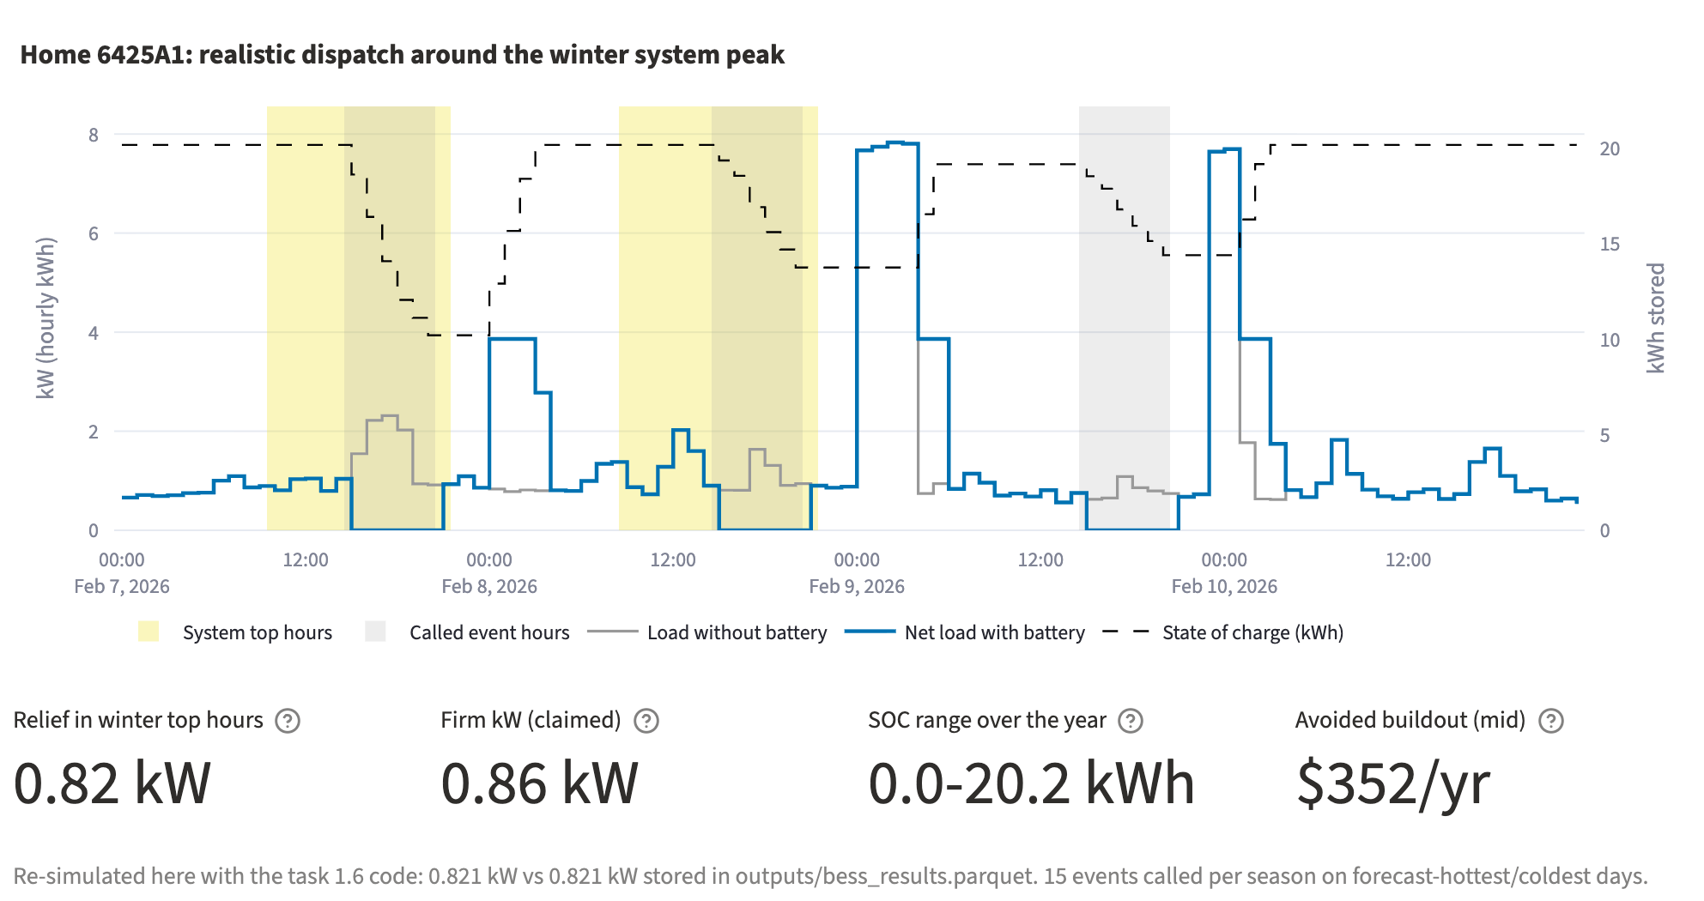
Batteries run hour by hour within their energy limit
BATTERY METHOD
2 × Enphase IQ 10C (20.16 kWh, 7.68 kW, 89.4% round trip), simulated over the full year for 22,682 candidate homes
Flat discharge ≤ 7.68 kW across the event window, never more than the home's load (no export)
Overnight recharge 00-05 h only, never above the home's own p95 load (no new peak)
Multi-day events: state of charge carries across back-to-back hot or cold days
Realistic calls: 15 events per season on forecast hottest / coldest days
Claim firm kW, not nameplate: the level held through the whole window
Realistic dispatch delivers 67% (summer) / 58% (winter) of perfect-foresight relief

Slide 15
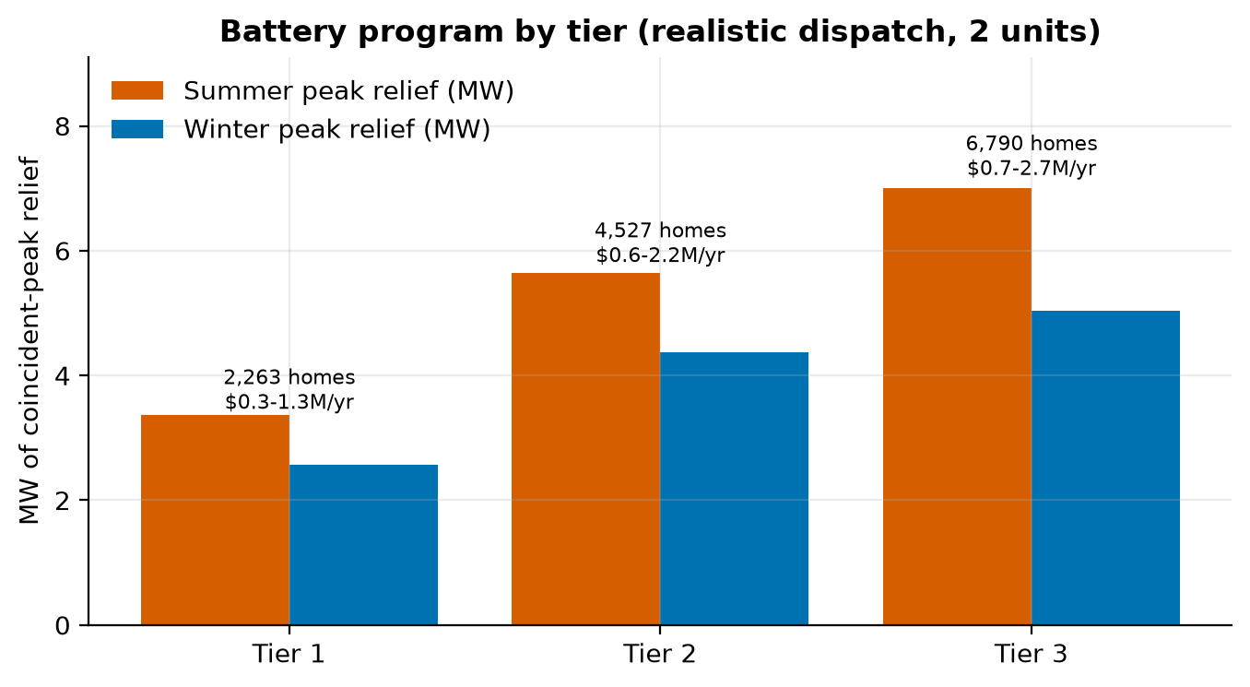
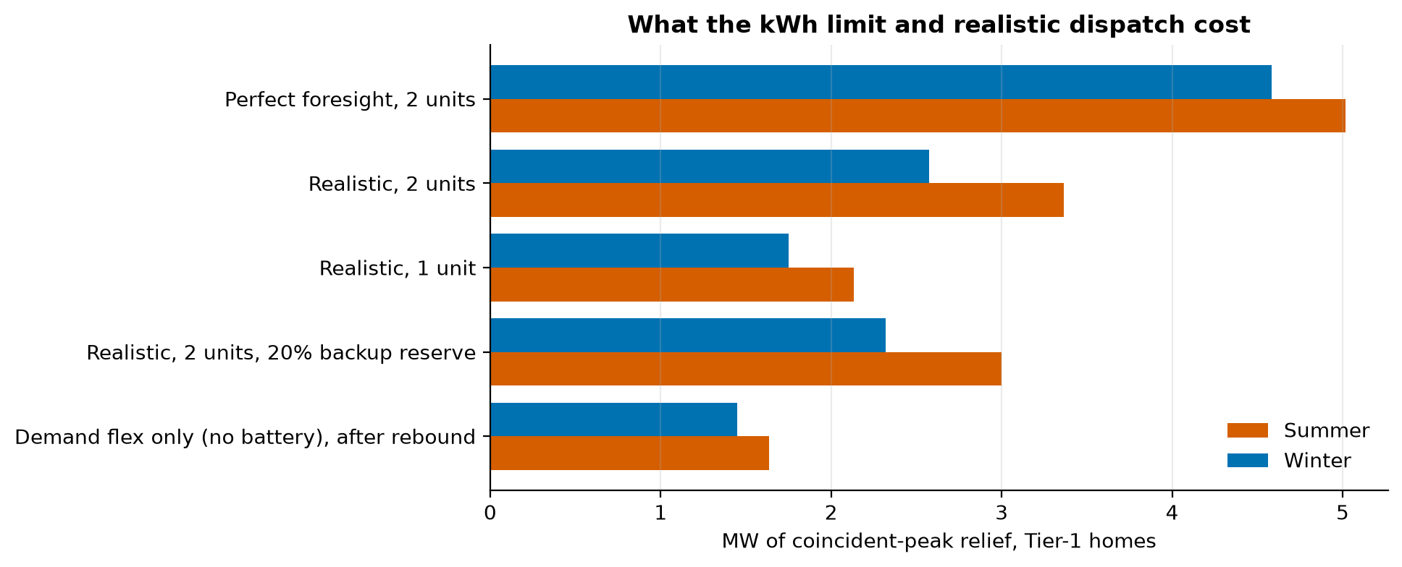
2,263 Tier 1 homes cut 3.4 MW summer, 2.6 MW winter
BATTERY RESULTS
Coincident-peak relief by tier (left) and what the kWh limit and realistic dispatch cost for Tier 1 (right)
1,383
844
36
1.49 / 1.14 kW
Tier 1 homes: 2 units cover their peaks
need 2 units plus demand flex
fully covered by 1 unit
relief per Tier 1 home (summer / winter)

Slide 16
Avoided buildout alone does not pay for a battery
BUSINESS VALUE
So the program should target where value stacks: constrained feeders, electrification headroom, customer value
$335/yr
Avoided-cost assumptions ($/kW-yr, placeholders pending Avangrid's values)
Component | Low | Mid | High | Applied to
Capacity | 30 | 60 | 100 | relief at the annual system peak
Transmission | 50 | 100 | 150 | mean of summer and winter relief
Distribution deferral | 25 | 75 | 150 | max of summer and winter relief
avoided buildout per Tier 1 home (mid)
$3,051
Constrained feeders
Electrification headroom
Customer value
NPV per Tier 1 home over 15 years at 7%
distribution deferral is local: place batteries where an upgrade is deferred
keep heat-pump and EV adopters inside 3 kVA without a service upgrade
backup power and TOU bill savings stack on top of grid value
$0.3-1.3M
per year for all Tier 1 homes (low-high)

Slide 17
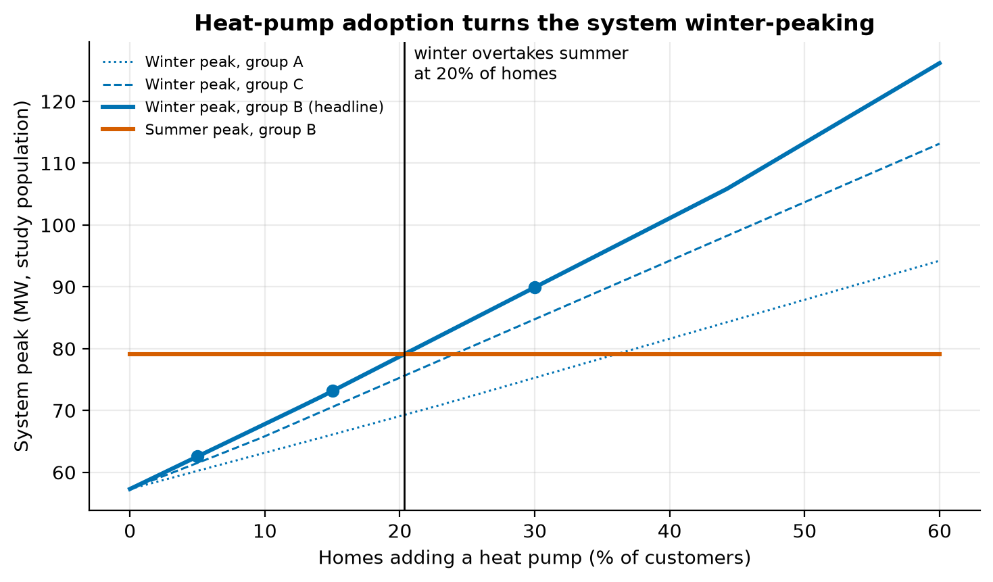
Winter overtakes summer at ~20% heat pumps
FORWARD LOOK
System peak vs share of homes adding a heat pump, built from the measured heating response of labeled heat-pump homes
72%
today's winter peak vs summer (57.3 vs 79.1 MW)
20%
heat-pump adoption where winter overtakes summer (range 20%-36% across donor groups)
89.9 MW
winter peak at 30% adoption (summer 79.1 MW)
+2.9 kW
per adopting home at the winter peak

Slide 18
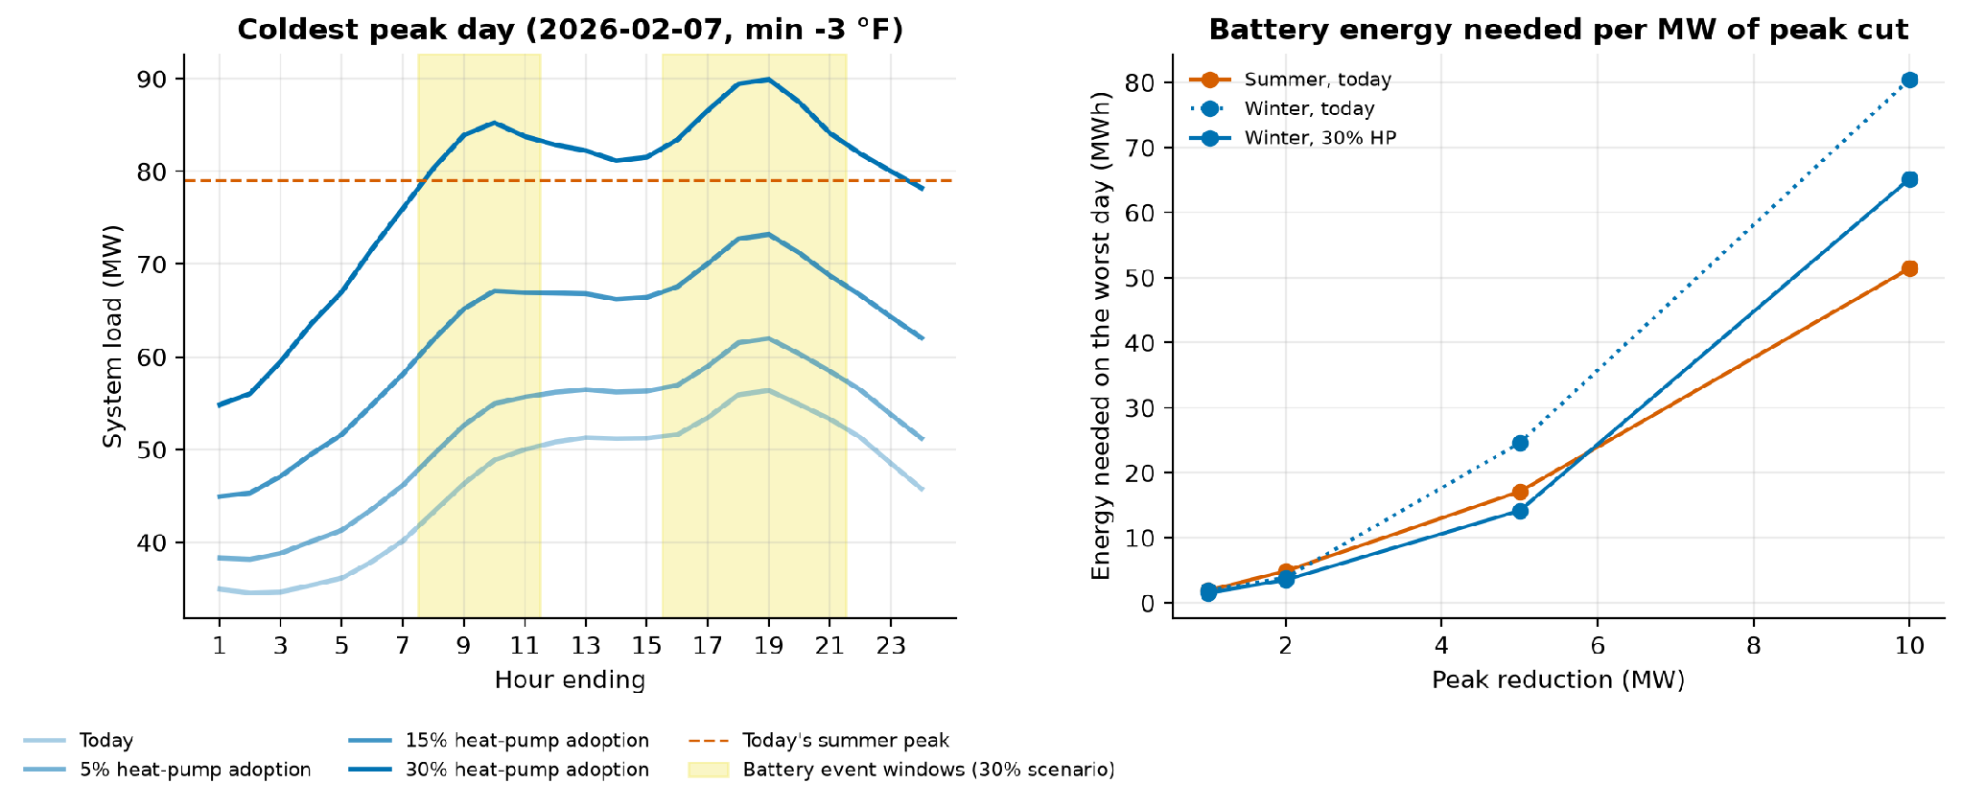
A winter peak demands coordinated battery recharge
FORWARD LOOK
The coldest peak day under each adoption scenario (left) and the battery energy needed per MW of peak cut (right)
108 MW
89.9 → 84.0 MW
0.85 kW
night peak if batteries recharge uncoordinated (30% adoption)
annual peak with coordinated fleet recharge
winter relief per adopter home, coordinated

Slide 19
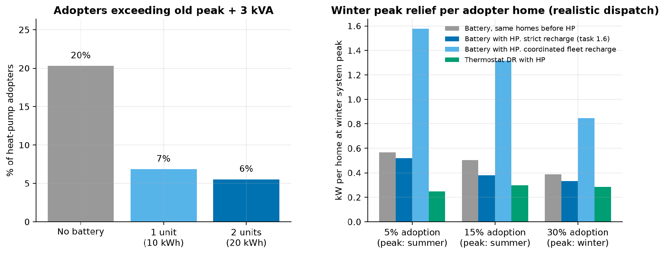
Batteries keep most overloaded adopters within 3 kVA
ELECTRIFICATION ENABLEMENT
Heat-pump adopters exceeding their old peak + 3 kVA, without and with a battery (left); winter relief per adopter (right)
20%
66%
73%
of adopters exceed old peak + 3 kVA (median 12 h/yr)
of those brought within the cap by 1 unit
brought within the cap by 2 units

Slide 20
A program for every segment, sized in homes and MW
PROGRAM PLAYBOOK
Now = launch with today's data · Next = after a pilot or confirmed avoided-cost values · Watch = monitor, no offer yet
When | Segment | Program | Target | Tier 1+2 MW, S / W
Now | Electrified: EV + electric heat | Battery + managed EV charging + heat DR bundle | 768 Tier 1+2 homes | 1.12 / 0.96
Now | Electric-heat home | Batteries for Tier 1; resistive → heat-pump conversion; weatherisation | 2,717 Tier 1+2 homes | 3.43 / 2.53
Now | EV home | Managed charging / EV TOU; batteries for Tier 1 | 1,563 homes (515 Tier 1) | 1.49 / 1.20
Next | Summer peak contributor | AC thermostat DR (mass); batteries on summer-constrained feeders | 763 Tier 2 homes | 1.09 / 0.74
Next | Winter peak contributor | Batteries (year-round value); heat-pump-ready audits | 333 Tier 2 homes | 0.45 / 0.45
Next | Solar PV | PV + storage retrofit for winter evenings | 88 Tier 1+2 homes | 0.08 / 0.09
Next | Typical | TOU + behavioural DR; heat pumps sold with managed controls | 20,237 homes | 1.30 / 0.93
Watch | Emerging load | Transformer watch-list; EV / heat-pump readiness outreach | 202 homes | 0.01 / 0.01
Watch | Very high load / non-residential | Rate-class review; commercial storage / C&I DR | 28 accounts | 0.04 / 0.03
None | Low use / seasonal | No program (vacancy / meter-health only) | 1,885 homes | n/a

Slide 21
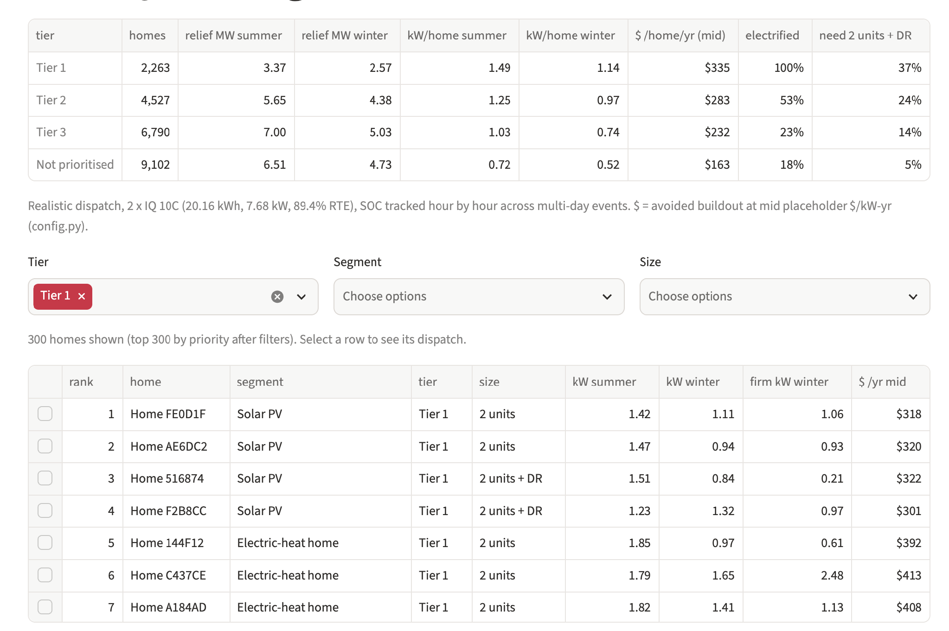
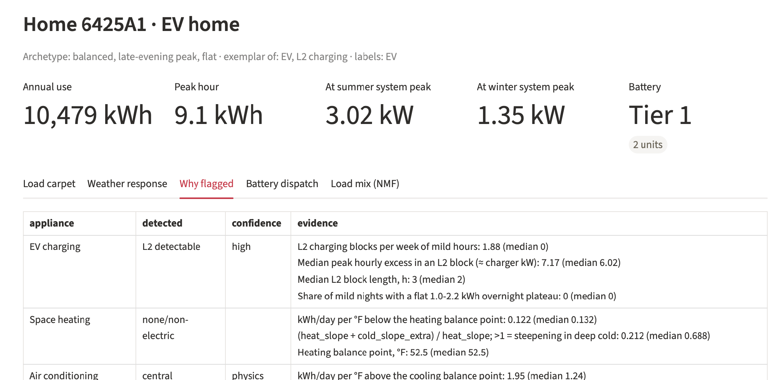
A local app shows every home's evidence in one click
DASHBOARD
streamlit run app/streamlit_app.py · four views on cached outputs, each under 0.2 s · customer IDs anonymised
Customer lookup · why flagged: each appliance's evidence vs the population median
Battery ranking: filter by tier, segment and size; select a home to see its dispatch
Repository: pipeline (scripts/run_all.sh), app, README with setup and run steps, requirements.txt · https://github.com/charleslrt20/avangrid_hackathon

Slide 22
Thank you
Electrified homes drive the peak, and the winter peak is coming.
Target batteries where value stacks, pair them with managed charging and heat-pump programs, and coordinate the fleet before heat pumps scale.
https://github.com/charleslrt20/avangrid_hackathon

Slide 23
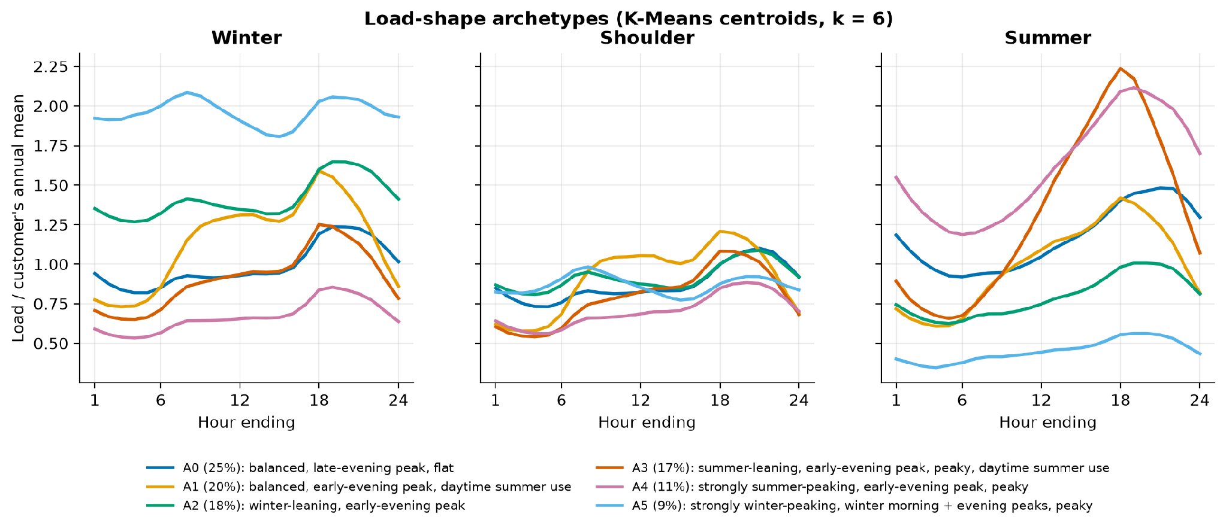
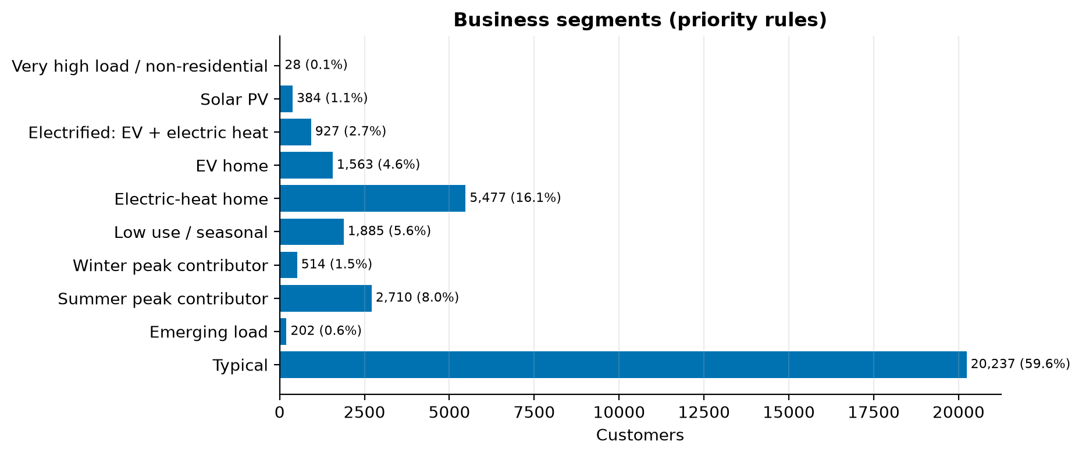
Segment sizes and load-shape archetypes
APPENDIX
Rule-based segments (left); K-Means archetypes on normalised seasonal shapes form a continuum (right)
K-Means silhouette / Davies-Bouldin = 0.133 / 1.86: archetypes on a continuum, not separable clusters, so the rule segments are primary.
Notes:
K-Means silhouette and Davies-Bouldin: 0.133 / 1.86. Shapes form a continuum, which is why we added NMF.

Slide 24
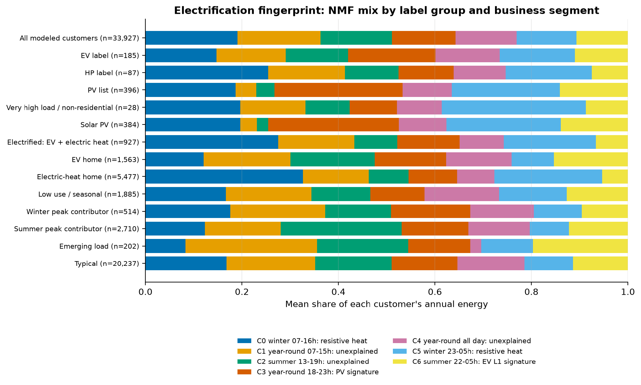
Electrification fingerprint by segment
APPENDIX
Mean share of each customer's annual energy explained by each NMF part
Notes:
Electric-heat homes: about 55% of energy in the winter heating parts. Emerging-load homes carry more year-round daytime and summer overnight load than typical homes.

Slide 25
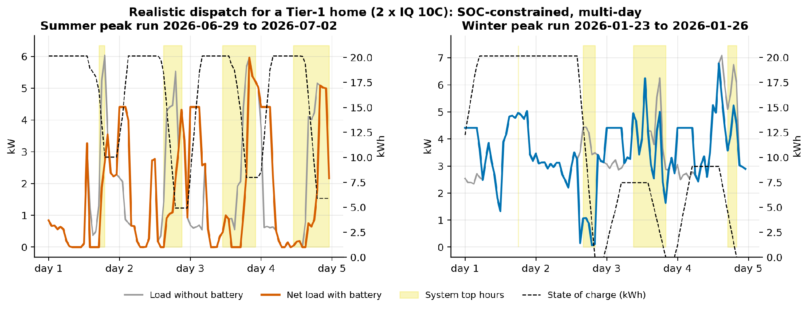
Battery dispatch for a Tier 1 home, summer and winter
APPENDIX
Static version of the app view: load, net load with battery, system top hours and state of charge across multi-day peak runs

